Slide 1
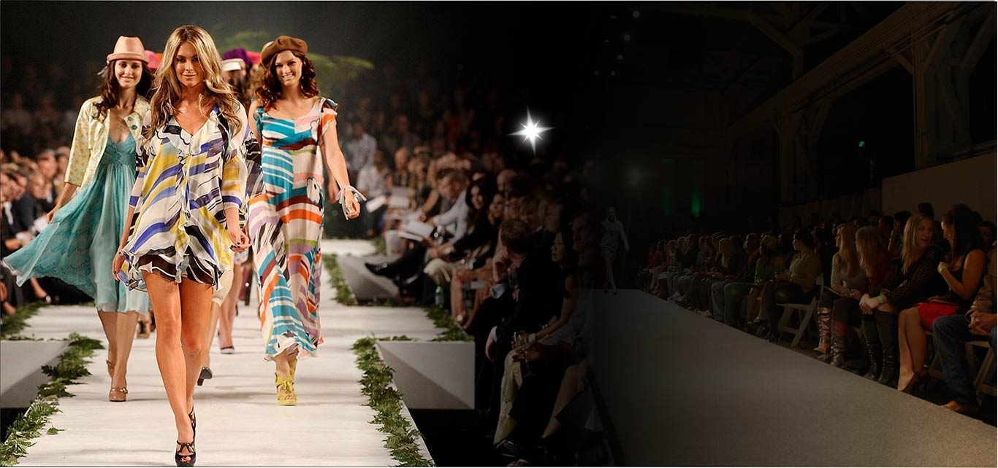
Unit Three
Fashion
Statements

Slide 2
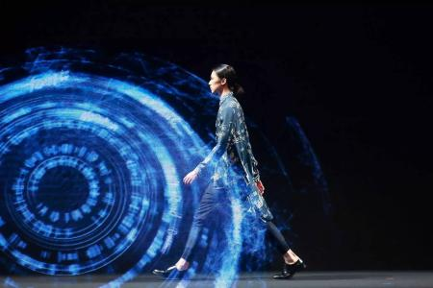


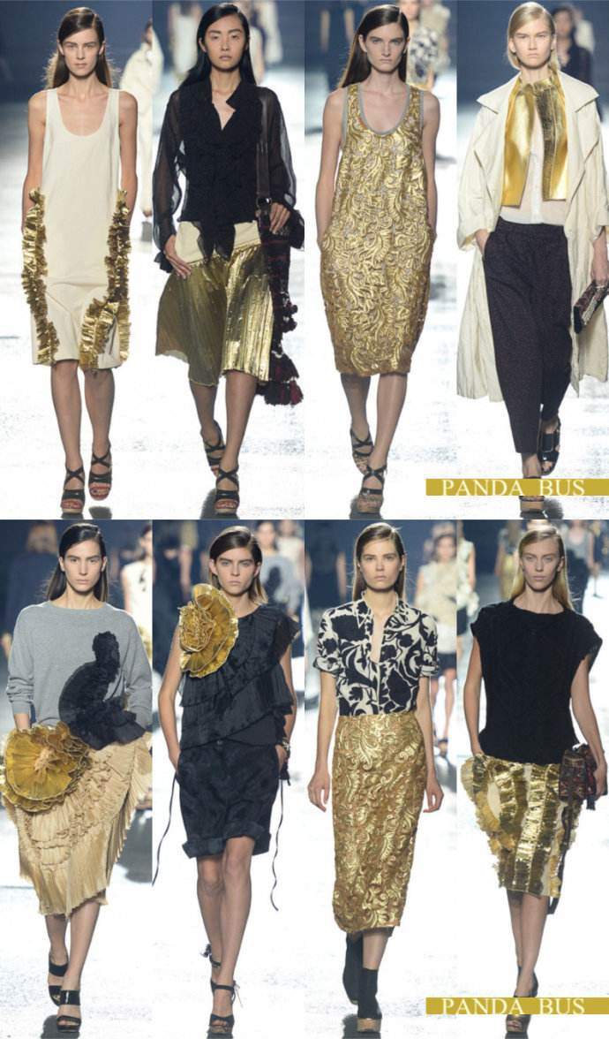
Warm-Up
Listen to a passage which contains many idiomatical expressions on clothing. Take notes while listening and explain the following idioms in English.
1. have ants in one’s pants
2. wear the pants in the family
3. burn a hole in one’s pocket
4. tighten one’s belt
5. take one’s hat off to sb.
6. sb. is too big for his boots
7. sb. is a stuffed shirt
8. wear one’s heart on the sleeve
9. lost one’s shirt
10. roll up one’s sleeves

Slide 3
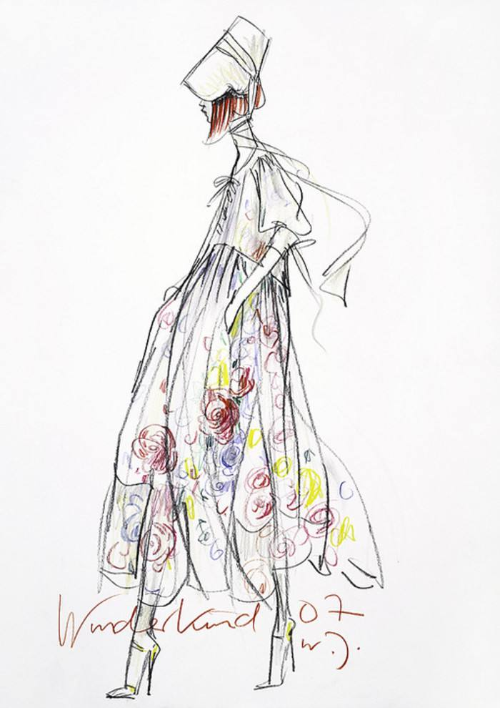
Warm-Up
Warming Up
have ants in one’s pants
Sb. is restless or nervous.
wear the pants in the family
takes control in the family
burn a hole in one’s pocket
money is likely to be spent quickly
tighten one’s belt
have to live on less money and spend money carefully
take one’s hat off to sb.
praise sb.

Slide 4

Warm-Up
Warming Up
sb. is too big for his boots
Sb. thinks he / she is more important than he / she really is.
sb. is a stuffed shirt
Sb. is too firm and severe.
wear one’s heart on the sleeve
show one’s feeling openly
lose one’s shirt
be too smart to lose all or most of one’s money
roll up one’s sleeves
prepare to work hard
Script

Slide 5
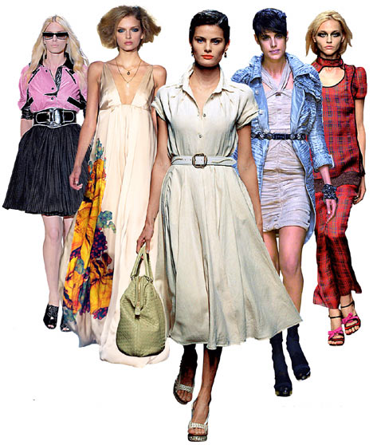
Warm-Up
Warming Up
Answer the following questions to see whether you are fashion-conscious or not.
Which of the following prepositions means that something is fashionable?
A) up
B) down
C) in
D) out

Slide 6
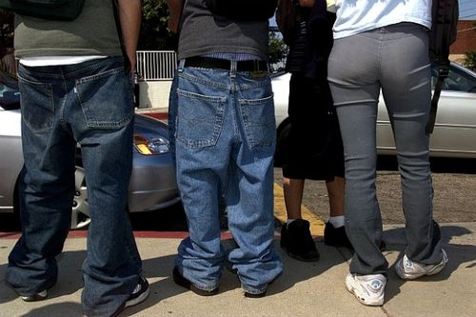
Warm-Up
Warming Up
If a piece of clothing is a bit big and loose on the body, which word would we use in English to describe it?
A) loosy
B) baggy
C) tight
D) shaggy

Slide 7
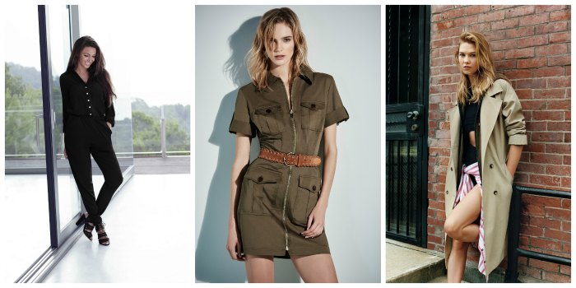
Warm-Up
Warming Up
When British people talk about “high street fashion” – what do they mean?
A) Clothes that they bought at a shop on a main road
B) Expensive designer clothes
C) Clothes bought from one of the many chain fashion shops that you typically see in all towns across Britain
D) Clothes that you can only wear outside
Left to right: Lipsy, River Island, Topshop

Slide 8
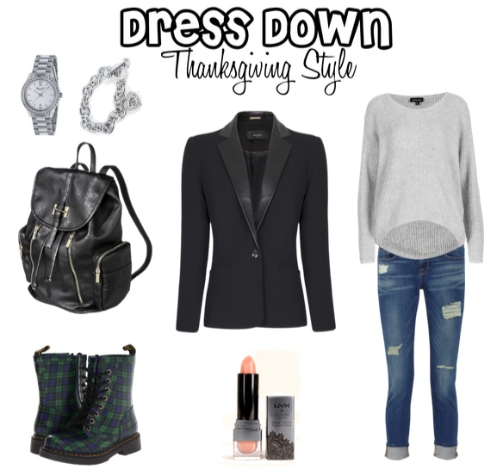
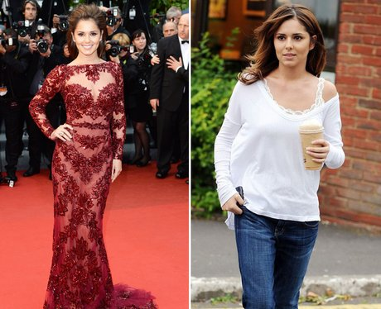
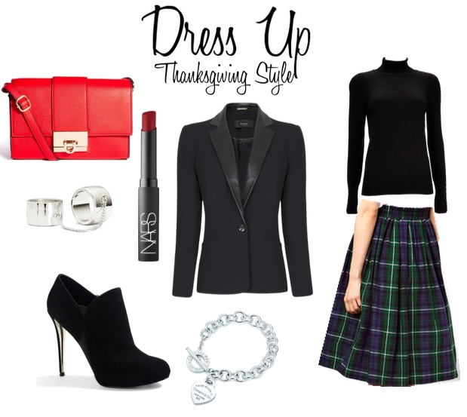
Warm-Up
Warming Up
Which of the following expressions does NOT mean to be really dressed up in very nice clothes?
A) Dressed to kill
B) Dressed to the nines
C) Dolled up
D) Dressed down

Slide 9
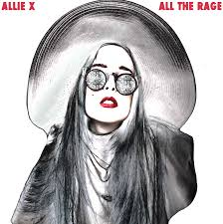
Warm-Up
Warming Up
Which of the following is another common expression meaning fashionable?
A) All the rage
B) All the anger
C) All the fury
D) All the upset

Slide 10
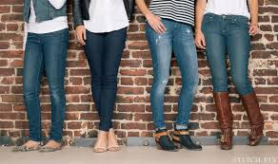
Warm-Up
Warming Up
Skinny jeans are fashionable in the UK at the moment – but what are they?
A) Jeans that make you lose weight
B) Jeans that make you look thinner
C) Very long jeans
D) Very tight jeans

Slide 11
Warm-Up
Work in pairs and match the terms related to clothing with their translation.
loafers
polo shirts
jeans
sweater
outfit
fabric
wardrobe
马球衫
毛线衣，运动衫
面料，织物
全套服装
衣橱
平跟船鞋；懒汉鞋；平底便鞋
牛仔裤

Slide 12
Warm-Up
Work in pairs and match the terms related to clothing with their translation.
孕妇装
宽边帽
背心装
高筒皮靴
婚纱
婴儿服
胶底运动鞋
wedding dress
maternity wear
baby clothes
broad-brimmed hat
tank top
high leather boots
sneakers

Slide 13
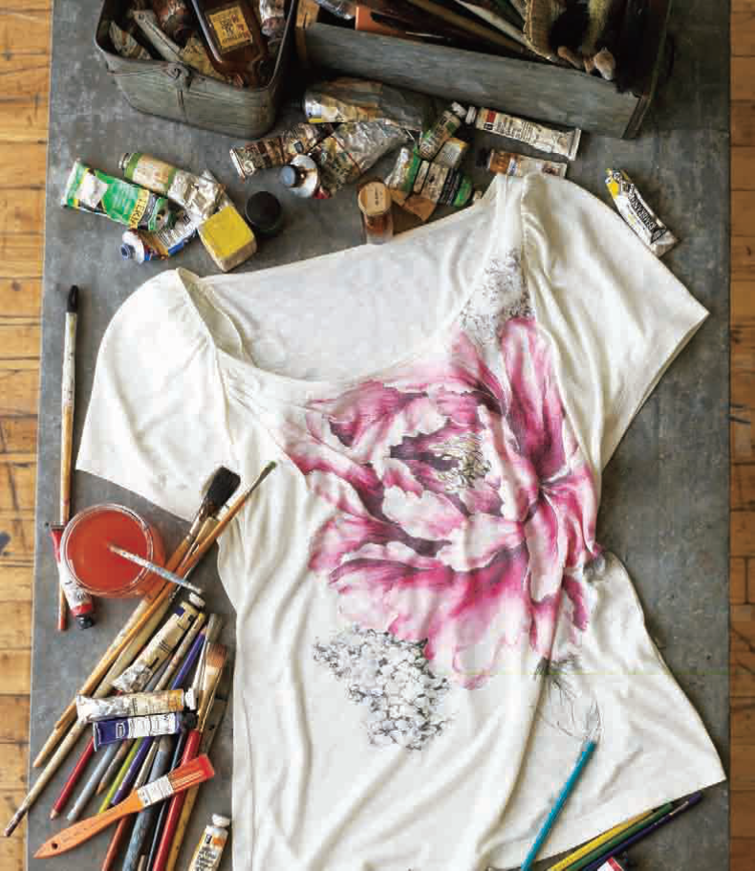
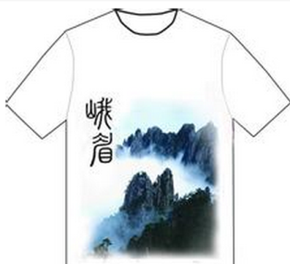
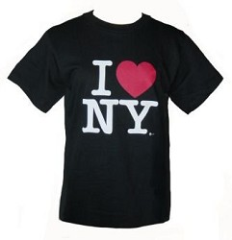
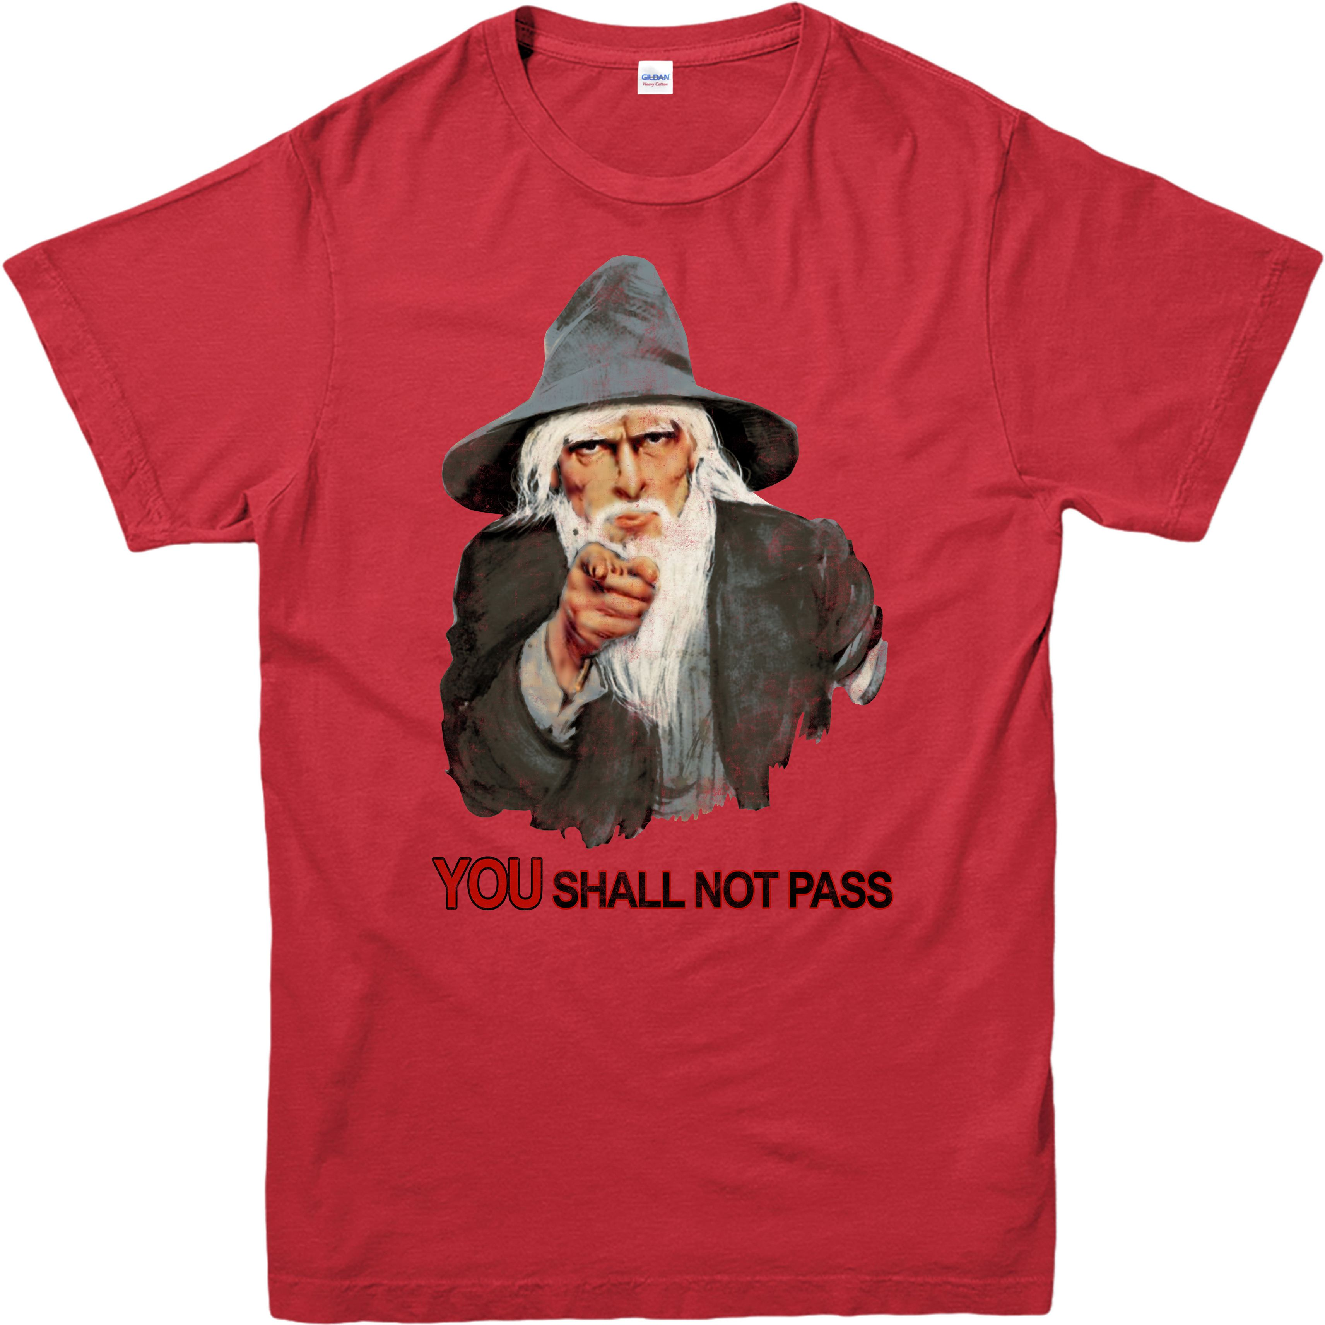
Text Organization
Been there, done that, got the T-shirt

Slide 14
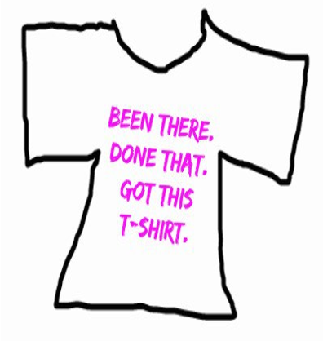
Text Organization
Introduction
Body
Conclusion
I
II
III
Notes:
Fashion is starting to make me feel old. I am seeing things become fashionable again that I not only remember from the first time, but I spent my entire part time job pay packet on.
There are many things I have worn that my small people will one day either laugh at, or cringe at how embarrassing I am. Some of these things I hope never become fashionable again.

Slide 15

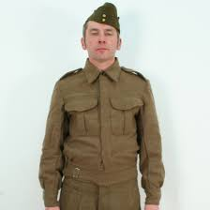
Text Organization
Introduction
The father’s
battle jacket
I
Story:
2nd day of D-Day invasion
On a Normandy beach
Father was wounded
superficial wound
but
the bullet hole on the battle jacket
5 cm to the right, heart
a reminder of historical event
a mortal wound
Notes:
Fashion is starting to make me feel old. I am seeing things become fashionable again that I not only remember from the first time, but I spent my entire part time job pay packet on.
There are many things I have worn that my small people will one day either laugh at, or cringe at how embarrassing I am. Some of these things I hope never become fashionable again.

Slide 16
Text Organization
Conclusion
The father’s
battle jacket
III
the bullet hole on the battle jacket
5 cm to the right, heart
a reminder of what？
Notes:
Fashion is starting to make me feel old. I am seeing things become fashionable again that I not only remember from the first time, but I spent my entire part time job pay packet on.
There are many things I have worn that my small people will one day either laugh at, or cringe at how embarrassing I am. Some of these things I hope never become fashionable again.

Slide 17
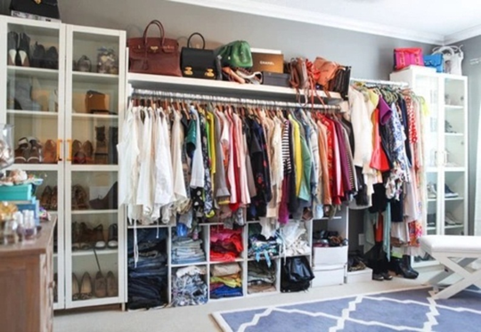
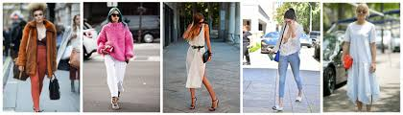
Text Organization
Body
The father’s
battle jacket
II
Clothes:
What do we people dress for?
Notes:
Fashion is starting to make me feel old. I am seeing things become fashionable again that I not only remember from the first time, but I spent my entire part time job pay packet on.
There are many things I have worn that my small people will one day either laugh at, or cringe at how embarrassing I am. Some of these things I hope never become fashionable again.

Slide 18
Text Organization
Body
Clothes
prehistoric purpose of clothes:
dress for comfort
dress for fashion
dress for favourable impression
functional
be warm
be waterproof
protect our
modesty
a Scandinavian
saying
fashionistas
at the expense of
comfort and
practicality
disguise
themselves or
avoid attracting
attention
Functions
express
emotions
give a sense
of occasion

Slide 19
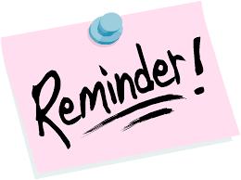
Text Organization
Body
Clothes
lives
events
of
emotions
nostalgia
who we are today

Slide 20
Summarising
Text Organization
Summarise the text by filling in the blanks.
Clothes serve different functions. My father’s old battle jacket is a ______________ of historical event, D-Day.
Originally, the clothes are purely functional.
However, till today we have to make choices: dressing for comfort or dressing for fashion. ______________ dress for fashion at the ______________ of comfort and practicality. What’s worse, they may end up as fashion ______________.
Some people choose clothes to impress others. Anyway, fashion can express our ___________ and also give a sense of occasions.
Our clothes are indicative of our lives, the events, the emotions, the sense of __________ for yesterday’s innocence and the chastening, ______________ reminder of who we are today.
reminder
Fashionistas
expense
victims
emotions
nostalgia
humbling

Slide 21
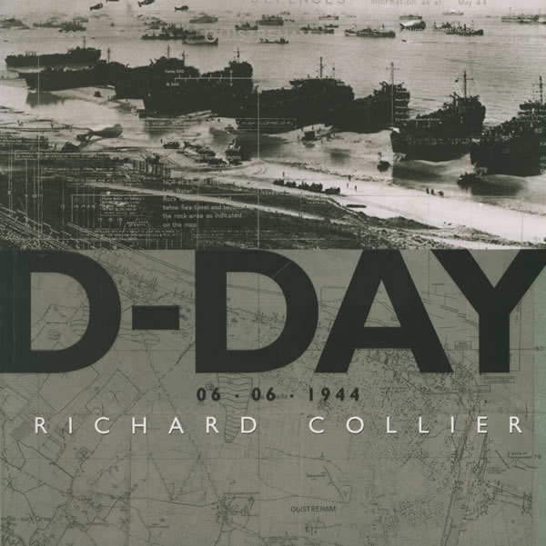
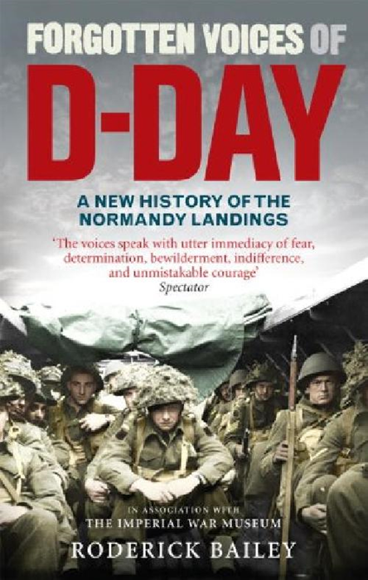
Cultural Notes
The Allied soldiers suffered many casualties during the first few days as they tried to consolidate their position all the way along the Normandy coast. But the invasion of Normandy led to the liberation of France from Nazi control and ultimately to an Allied victory in Western Europe.
D-Day on 6 June 1944: the day when the first Allied troops landed in Normandy, in northern France, to engage with the German occupying forces.

Slide 22
Difficult sentences
1. Many of them love the glamour of the fashion shows in Milan, Paris, London and New York. They like to gauge and witness the latest trends as worn by models of uniform build and exquisite beauty, who are quite unlike most ordinary people. (Para 4)
2. Finally, those people who claim to have no interest in fashion usually choose sombre colours as a form of camouflage, to disguise themselves and to avoid attracting attention to themselves. (Para 5)
3. We keep clothes which remind us of the difference between what we wanted to be at one point of our lives, and what we are today. (Para 10)
click
click
click

Slide 23
Difficult sentences
Many of them love the glamour of the fashion shows in Milan, Paris, London and New York. They like to gauge and witness the latest trends as worn by models of uniform build and exquisite beauty, who are quite unlike most ordinary people. (Para. 4)
Translate the sentences into Chinese.
他们中许多人无法抵挡米兰、巴黎、伦敦及纽约时装秀的魅力，他们到那里去鉴赏并见证由身材标准、相貌出众的模特儿所展示的服装最新趋势，这些模特儿跟大多数普通人不一样。

Slide 24
Difficult sentences
2. Finally, those people who claim to have no interest in fashion usually choose sombre colours as a form of camouflage, to disguise themselves and to avoid attracting attention to themselves. (Para. 5)
Translate the sentences into Chinese.
最后，还有那些声称对时装没有兴趣的人，他们往往会选择暗色的衣服作掩护，伪装自己，避免吸引别人的目光。

Slide 25
Difficult sentences
3. We keep clothes which remind us of the difference between what we wanted to be at one point of our lives, and what we are today. (Para. 10)
Translate the sentences into Chinese.
我们保存某些衣服，是为了让我们想起生命中某个时期理想的自我与如今现实的自我之间的差异。

Slide 26
dodge v.
Words & Expressions
to avoid sb. or sth. by moving quickly, especially so that sth. does not hit you or sb. does not see you 闪开；躲开
Work in pairs and translate the sentences or words into Chinese.
The president had to dodge the flying tomatoes.
总统不得不躲闪飞来的番茄。
The implication of the crackdown extended to the wealthy investors who have never been tempted to dodge taxes.
这场打击行动的影响已经波及到那些从不妄图逃税的富人。

Slide 27
superficial a.
Words & Expressions
◆ affecting only the surface of your skin or the outside part of sth., and therefore not serious 表皮的，表面的
skin-deep
shallow
❖ not studying or looking at something carefully and only seeing the most noticeable things 肤浅的，浅薄的
That is the highly superficial analysis of the situation.
那是对局势很肤浅的分析。
She escaped with only superficial cuts and bruises.
她侥幸躲过一劫，只受了点皮外伤。

Slide 28
mortal a.
Words & Expressions
serious enough to cause death
Word family: mortality n.
Antonym: immortal a.
Work in pairs and translate the collocations.
mortal enemy
mortal sin
mortal flaw
mortal fear
不共戴天的敌人
致命的缺陷
极度的恐惧
不可饶恕的罪行

Slide 29
waterproof a.
Words & Expressions
which not let water through
Work in pairs and find more similar word formation.
scratch proof
kiss proof lipstick
fire proof materials
wear-proof
防刮伤的
不脱色唇膏
耐磨的
耐火材料

Slide 30

Words & Phrases
Words & Expressions
low-maintenance a. not needing much effort or money 不太费劲的；费用低的
1. Having a low maintenance front yard is the goal of many people.
拥有一个维护成本低的前院是许多人的目标。
2. This is efficient, low maintenance learning.
这种学习既有效率又轻松。
Antonym: high-maintenance a.
She is such a high-maintenance woman.
她真是个难伺候的女人。

Slide 31
might (just)as well
Words & Expressions
(infml) used to suggest doing sth. because you cannot think of anything better to do 倒不如
Work in pairs. Fill in the blanks to complete the sentences.
You won’t enjoy your purchase from that online shop, you might as well wait for __________, the day when most consumers want to cut their fingers.
We are here on the planet only once, and might as well _______________________.
Nov 11
enjoy every day
might as well do A as do B
You might as well talk to a stone as try to argue with a stubborn woman.
与其跟一个倔女人理论，你不如对一块石头说话。

Slide 32
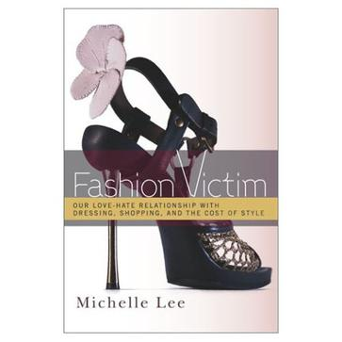
fashionista n.
Words & Expressions
sb. who is very interested in fashion or who works in the fashion industry 赶时髦者；时尚人物；时装界人士；时装界从业人员
Q: What is the difference between a fashionista and a fashion victim?
A: A fashionista follows the latest fashion tightly and they may end up as fashion victim.
Notes:
http://book.douban.com/subject/10538419/

Slide 33
at the expense of
Words & Expressions
at the cost of
Work in pairs and translate the sentence into English.
那个管弦乐团现在更有纪律性了，却丧失了灵魂。
The orchestra has more discipline now, but at the expense of spirit.
如果以环境为代价来发展工业是毫无意义的。
There is no sense developing industry at the cost of the environment.

Slide 34

glamour n.
Words & Expressions
charm or enchantment
Work in pairs. Translate the collocations.
a perfect incarnation of glamour
bombshell glamour
inject glamour to the city
glamour in one’s gene
魅力的完美化身
重磅魅力
为城市注入了魅力
骨子里的魅力

Slide 35
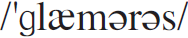
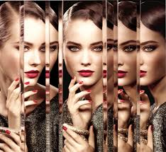
Words & Expressions
glamorous
attractive and interesting in an exciting and unusual way
极富魅力的；非常吸引人的
e.g.
1. On television she looks so beautiful and glamorous.
她在电视上看起来特别漂亮，魅力四射。
2. Such a glamorous dress seemed out of place in that cheap restaurant.
穿这样华丽的礼服去那家低档饭店，未免有些不合适。

Slide 36
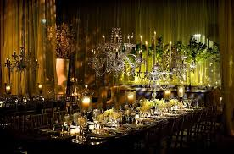
extravagant a.
Words & Expressions
wasteful; going beyond what is reasonable
Work in pairs and spot the very Chinese meanings of extravagant.
1. extravagant taste
2. an extravagant age
3. extravagant praise.
奢侈的品味
一个浪费的时代
过分的赞扬

Slide 37
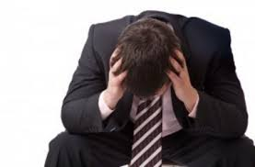
end up a.
Words & Expressions
finally be or do something
The stores will inevitably end up competing with each other in their push for increased market shares.
在努力争取更大的市场份额的过程中，这些商场最终将不可避免地相互展开竞争。
每次他们去跳舞，都会不欢而散。
Every time they went dancing they ended up in a bad mood...

Slide 38
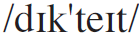
Words & Expressions
dictate v.
1) influence or control how sth. is done 影响；控制
e.g. Her skills were in such demand that she could dictate her own salary.
她因其技术奇货可居，故可以主宰自己的薪金待遇。
2) tell someone exactly what to do and how to behave 指定；命令
e.g. Don't try to dictate to children; they will obey you better if you ask them politely.
不要对孩子们发号施令，你如果礼貌地要求他们，他们会更听话的。

Slide 39
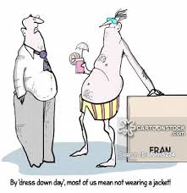
dress down
Words & Expressions
dress informally and casually
Work in pairs and make sentences by Q&A.
1. Why does he dress down?
He has been employed for ages.
2. Why does the star dress down in baggy clothes?
To avoid being recognised by her fans.
3. Should I dress up or dress down on the first date?
It depends.

Slide 40

highs and lows
Words & Expressions
good times and bad times 人生的得意与失意；人生的跌宕起伏
ups and downs
Work in pairs and translate the sentences into Chinese.
1. In the book, we look back at the highs and lows of the past year in the financial markets.
本书将回顾过去一年中金融市场的跌宕起伏。
2. Everybody will undergo highs and lows in his work or life.
每个人在工作和生活中都会经历起伏。

Slide 41
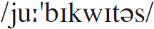
Words & Expressions
ubiquitous
a. (fml) present everywhere 普遍存在的；无处不在的
e.g.
1. Nobody at the time would ever have conceived of the telephone as being a ubiquitous personal object.
那时人们不会想到电话会成为无处不在的私人物品。
2. Generally, the local people stay up until very late, but they have limited options in spending the night hours besides dining out in the ubiquitous eating centers.
当地人睡觉的时间通常很晚，但这里的夜生活除了无处不在的美食场所外， 人们似乎并没有太多的选择。
Word family: ubiquity n. [U]

Slide 42
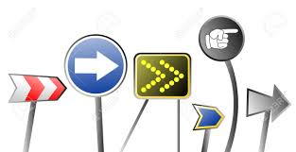
Words & Phrases
Words & Expressions
indicative a. (fml) showing that sth. will happen, is true, or exists 标示的；指示的；象征的；表明的
e.g.
1. Their failure to act is indicative of their lack of interest.
他们未采取行动，这表示他们没有兴趣。
2. His presence is indicative of his willingness to help.
他的出席表示他愿意帮忙。
3. His presence is indicative of his wish to join us.
他的现身表示他想加入我们。

Slide 43

rise and fall
Words & Expressions
Work in pairs and spot the very Chinese meanings of rise and fall.
1. Interest rates rise and fall according to the
health of economy.
2. The rise and fall of a nation depends on its
people.
3. His rise and fall is thought-provoking.
上下起伏
兴衰
人生起伏

Slide 44

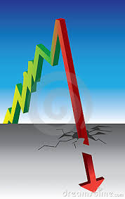
rise and fall
Words & Expressions
Work in pairs. Listen to the song Rise and fall and fill in the blanks.
Sometimes in life you feel _________________, and it seems as though the writings on the wall, Superstar _________________________, but once your picture becomes tainted (有瑕疵的), It’s what they call,
_______________________.
the fight is over
you finally made it
the rise and fall

Slide 45
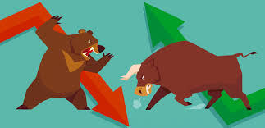
boom and bust
Words & Expressions
a situation in which a country’s economy regularly goes through periods of success followed by periods of failure
1. Like the US 2000-2001 boom and bust of tech stocks, the bursting of a major stock bubble can lead to a hard landing of the economy.
就像美国在2000-2001的科技股的繁荣与萧条一样，泡沫破灭可以使得经济硬着陆。
2. Alan Greenspan, often dubbed the second most powerful man in America, is obsessed with balancing the US economy between boom and bust.
被称为美国第二位有权力人物的艾伦·格林斯潘，总是为给美国经济繁荣与萧条寻找平衡而困扰。

Slide 46
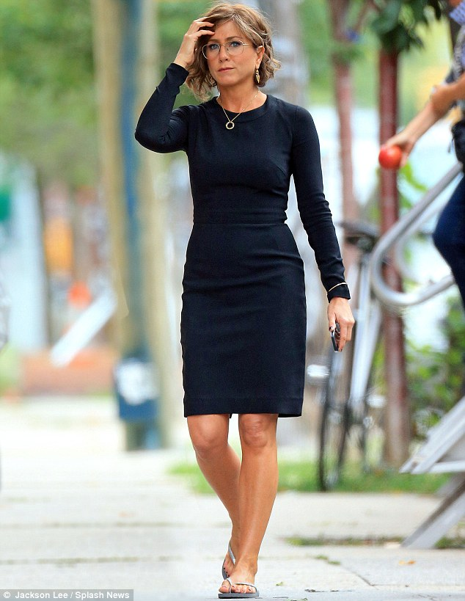
prim and proper
Words & Expressions
very careful about your behaviour and appearance, and easily shocked by what other people do or say
Work in pairs and translate the sentences into Chinese.
1. Tom is too prim and proper to enjoy jokes.
汤姆过于一本正经而无法消受笑话。
2. The prim and proper look was in in 2000.
循规蹈矩的样貌在2000年流行。

Slide 47
Useful Expressions
1.盟军登陆日
1. D-Day
2.躲避子弹
2. dodge the bullet
3.外表皮肉
3. the fleshy inner part
4.致命的伤口
4. a mortal wound
5.纯粹功能性的
5. purely functional
6.不太需要保养
6. low-maintenance clothes
7.时尚受害者
7. fashion victims
8.遭致非善意的反应
8. invite an unkind response
9.灰暗的颜色
9. sombre colours
10.有趣而时髦
10. fun and funky

Slide 48
Useful Expressions
11.结婚礼服裙
11. wedding dress
12.背心装
12. tank top
13.皮靴
13. leather boots
14.多色运动鞋
14. multi-coloured sneakers
15.宽边帽
15. broad-trimmed hat
16.受伤的脚踝
16. twisted ankle
17.怀旧之感
17. the sense of nostalgia
18.昨天的童真
18. yesterday’s innocence
19.震撼人心的提醒
19. humbling reminder

Slide 49
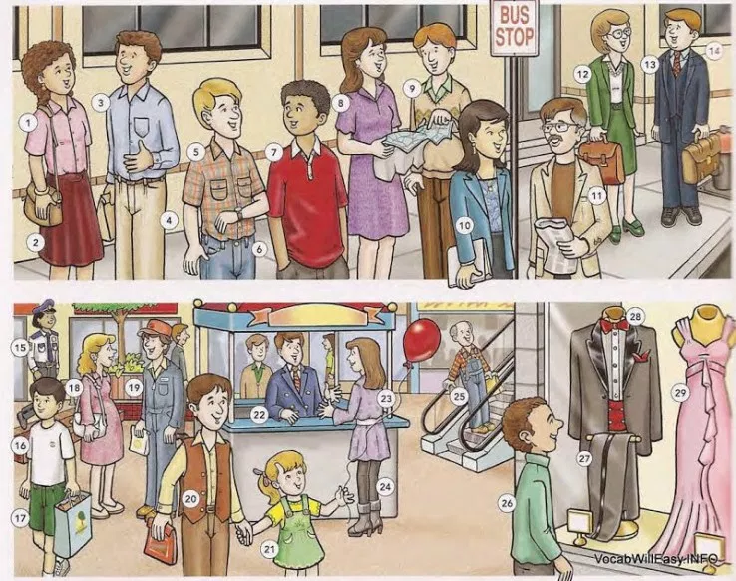
Clothing (Everyday Clothes)

Slide 50
Clothing (Everyday Clothes)
1 blouse 2 skirt 3 shirt 4 pants/slacks 5 sport shirt 6 jeans 7 knit shirt/jersey 8 dress 9 sweater 10 jacket 11 sport coat/
sport jacket/
jacket 12 suit 13 three-piece suit 14 tie/necktie
15 uniform 16 T-shirt 17 shorts 18 maternity dress 19 jumpsuit 20 vest 21 jumper 22 blazer 23 tunic 24 leggings 25 overalls 26 turtleneck 27 tuxedo 28 bow tie 29 (evening) gown

Slide 51
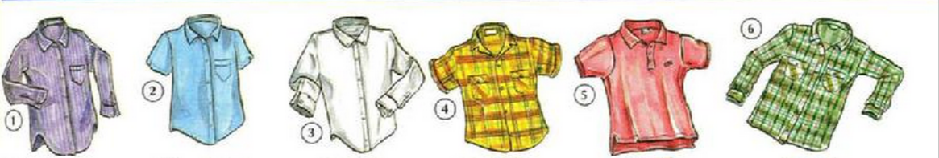
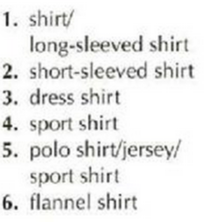
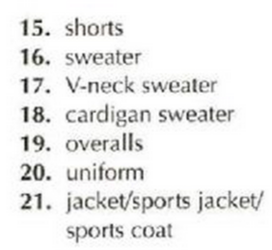
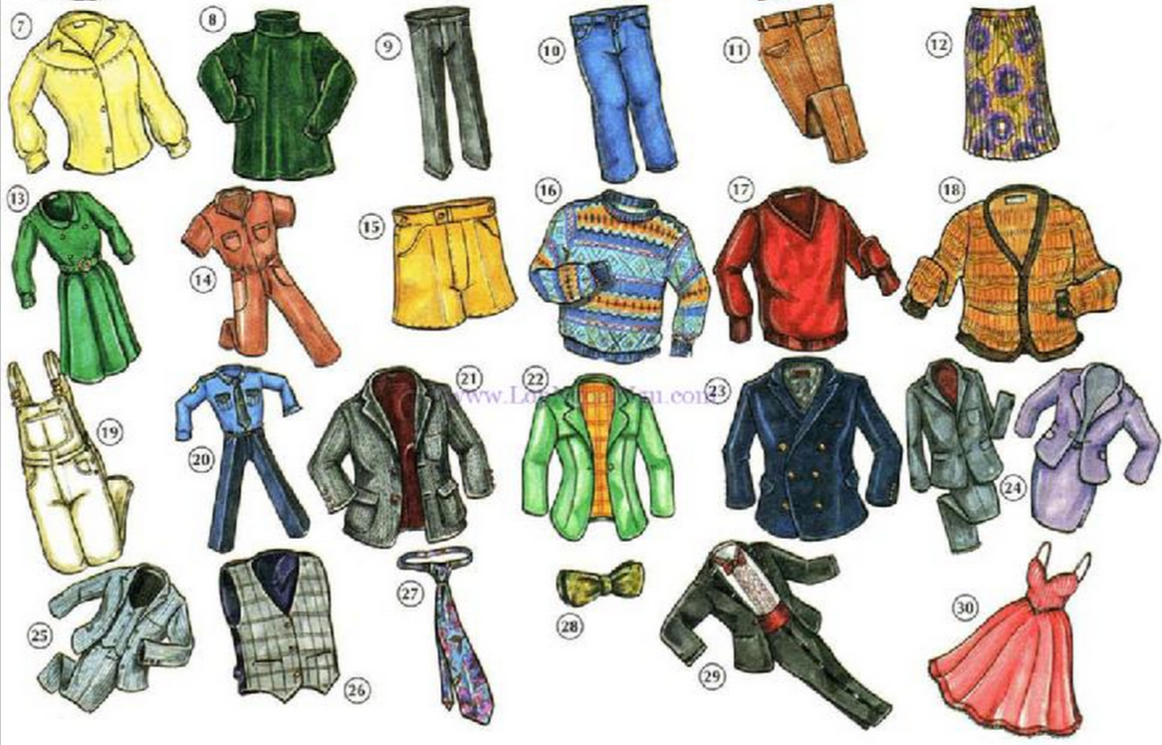
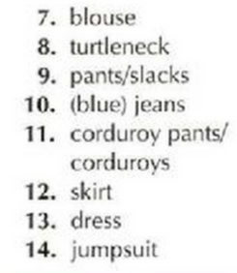
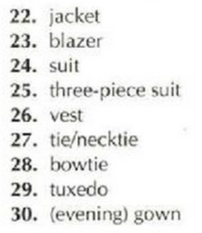
Clothing
Notes:
http://lopngoaingu.com/picture-dictionary/index.php

Slide 52
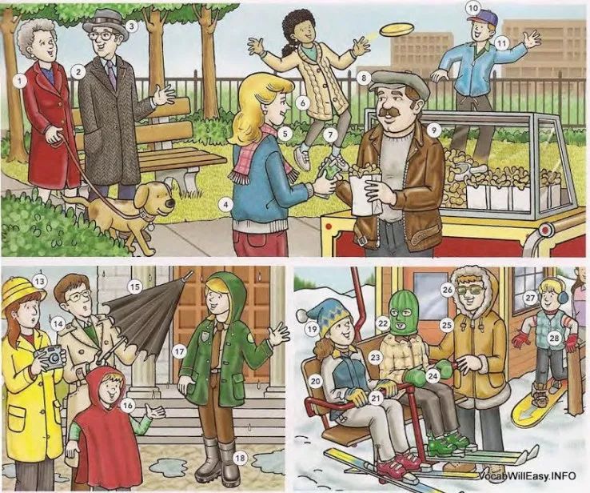
OUTERWEAR

Slide 53
OUTERWEAR
12 raincoat
13 rain hat
14 trench coat
15 umbrella
16 poncho
17 rain jacket
18 rain boots
19 ski hat
20 ski jacket
21 gloves
22 ski mask
23 down jacket
24 mittens
25 parka
26 sunglasses
27 ear muffs
28 down vest
1 coat
2 overcoat
3 hat
4 jacket
5 scarf/ muffler
6 sweater jacket
7 tights
8 cap
9 leather jacket
10 baseball cap
11 windbreaker

Slide 54
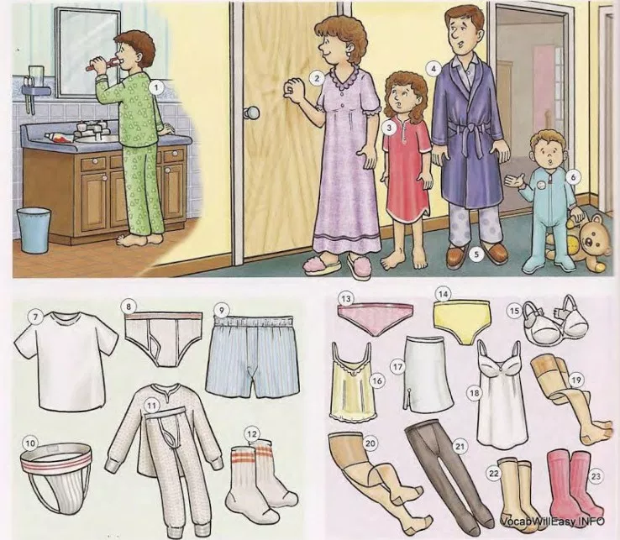
SLEEPWEAR AND UNDERWEAR

Slide 55
SLEEPWEAR AND UNDERWEAR
10 athletic supporter/
jockstrap
11 long underwear/
long Johns
12 socks
13 (bikini) panties
14 briefs/underpants
15 bra
16 camisole
17 half slip
18 (full) slip
19 stockings
20 pantyhose
21 tights
22 knee-highs
23 knee socks
1 pajamas
2 nightgown
3 nightshirt
4 bathrobe/robe
5 slippers
6 blanket sleeper
7 undershirt/T-shirt
8 (jockey) shorts/
underpants/
briefs
9 boxer shorts/
boxers

Slide 56
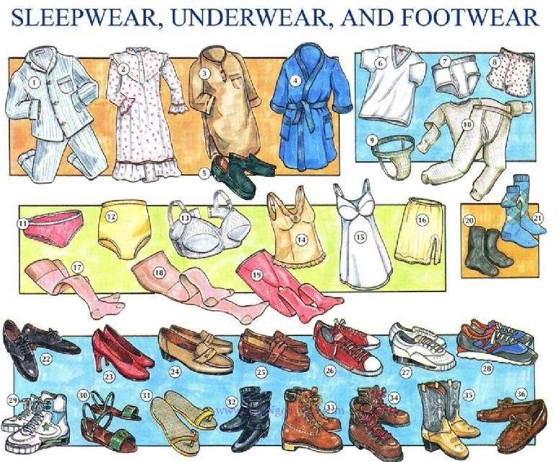
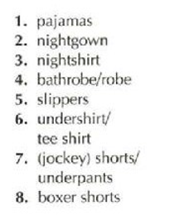
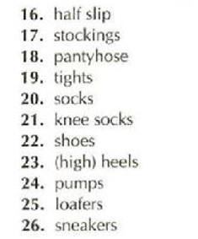
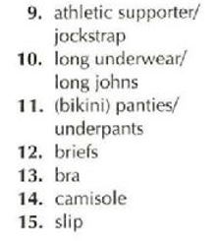
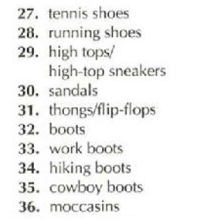

Slide 57
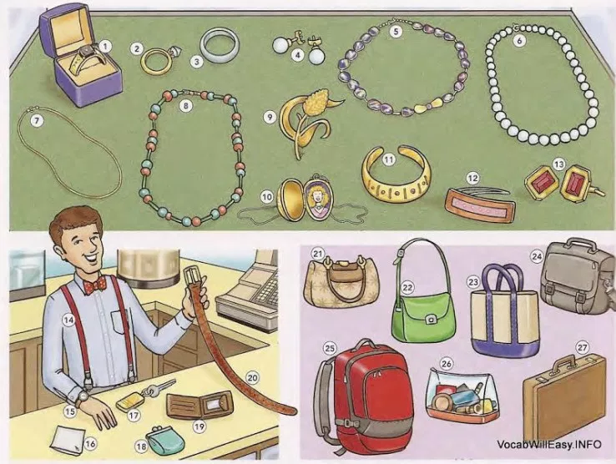
JEWELRY AND ACCESSORIES

Slide 58
JEWELRY AND ACCESSORIES
1 ring
2 engagement ring
3 wedding ring/
wedding band
4 earrings
5 necklace
6 pearl necklace/
pearls/
string of pearls
7 chain
8 beads
9 pin/brooch
10 locket
11 bracelet
12 barrette
13 cufflinks
14 suspenders
15 watch /
wrist watch
16 handkerchief
17 key ring/
key chain
18 change purse
19 wallet
20 belt
21 purse/
handbag pocketbook
22 shoulder bag
23 tote bag
24 book bag
25 backpack
26 makeup bag
27 briefcase

Slide 59

Putting on a Pair of Pants
Tom steps into his pants then he pulls them up.
He fastens the waistband and zips up the fly.
He slips a belt through the belt loops and buckles it.

Slide 60

Putting on a Shirt
Putting on a Shirt
Tom slips an arm into each sleeve.
He buttons the shirt and the cuffs.
He straightens his collar.
He tucks his shirt into his pants.
Notes:
https://kidspicturedictionary.com/

Slide 61

You snap things together. You zip something up. You button something. You lace something up and then you tie the laces. You clasp things together / You fasten something. You buckle something.

